Slide 1
BPDA | Brazilian Community Census Analysis
Team member: Zhihao Gu, Chenyang zhang, Minghui Yang, Xiaohan Zou, Pengchao Yuan.

Slide 2
Brazilian Community Census Analysis
Sponsored by Boston Planning & Development Agency (BPDA)
Project goal
Create visualizations using cleaned and processed data.
Identify trends in community demographics (throughout the US).
No background needed for the project
Notes:
The project Goals are divided into two parts, the first part is Create visualizations

Slide 3
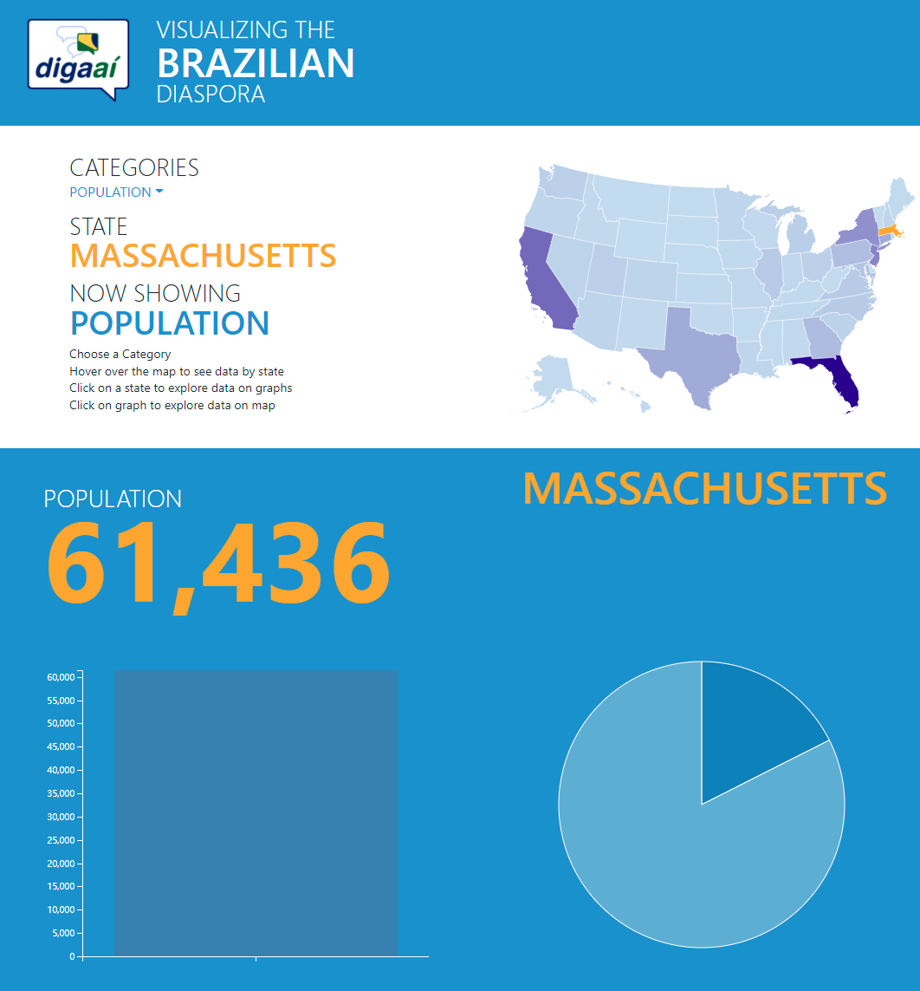
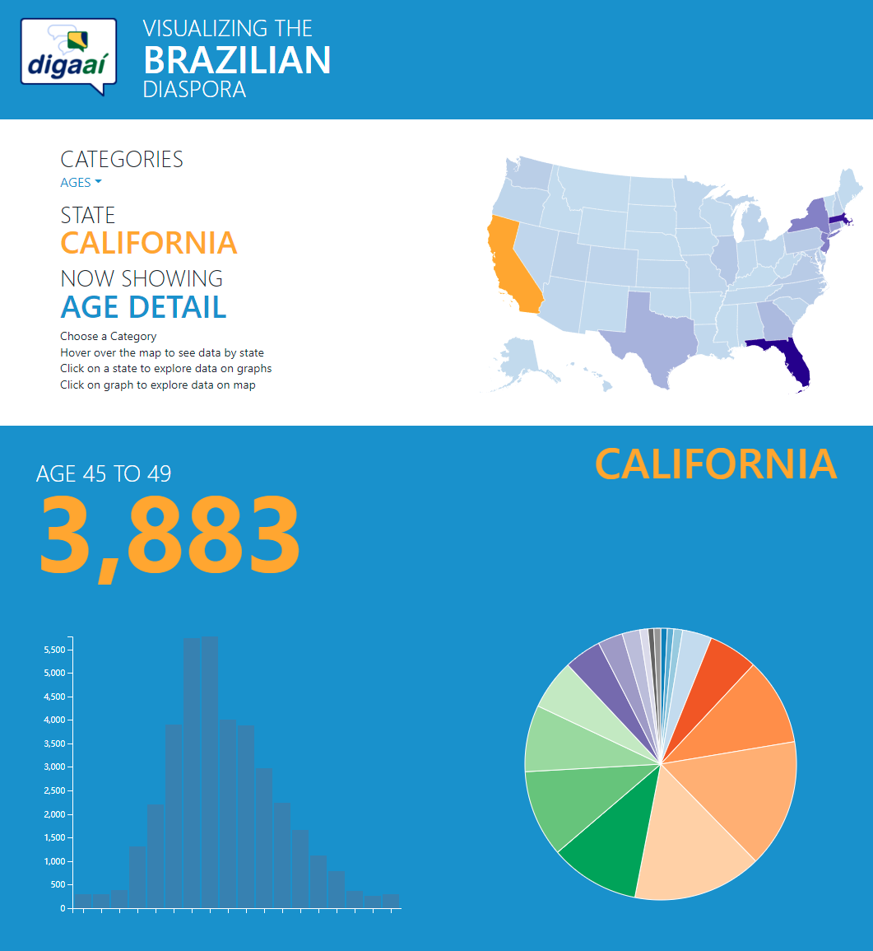
Previous work about Brazilian Community
https://digaai.herokuapp.com/
Notes:
They already have a website to show the data.
Not interactive enough
No comparison
Want: a more interactive way to show data, also find some patterns/trend,

Slide 4
Data
Data are provided
Preprocessed Brazilian Immigrants data
Population
Age distribute
Gender
Marital status
Citizenship
Education
Employment
Income
Both per year and per State
Notes:
We use the same data showed by the website.
Needs to fix error indexes, handle missing data

Slide 5
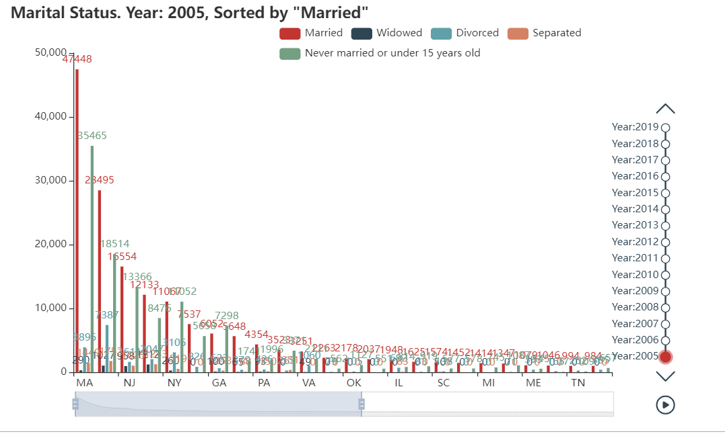
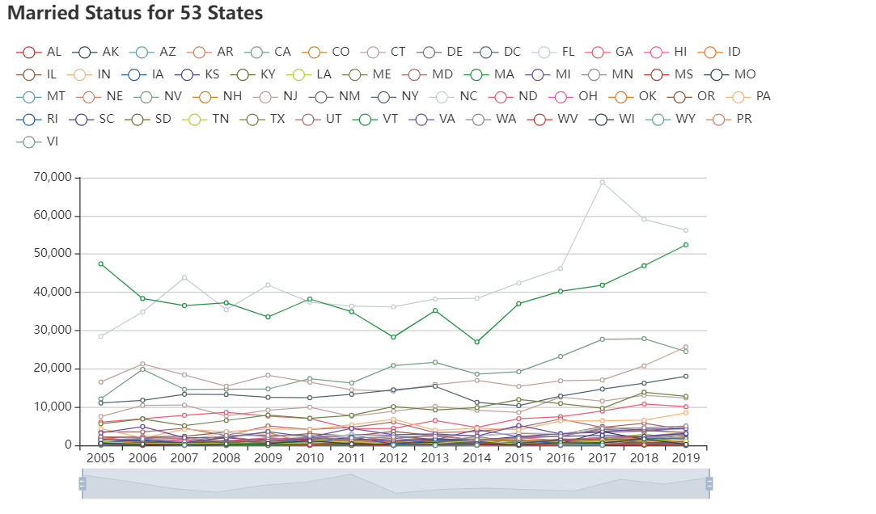
Visualization Part
Visualization by state
Visualization by year
Powered by pyecharts, an opensource JavaScript visualization library
Notes:
We use pyecharts to generate visualization.
It is easy to embed, including timeline, interactive, select what we want to display which meets the client’s requirements perfectly
We provide three different type of visualization
First is showing data by states
Second is showing data by year
Using these two types, we can Compare data between years and Compare data between states

Slide 6
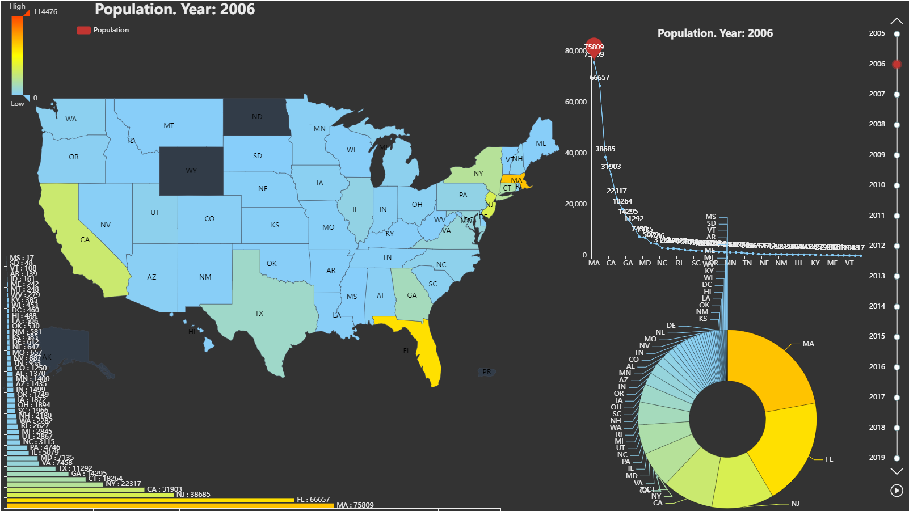
Visualization Part
Visualization by Heat Map
Showing data on the map
Color represents absolute value
Geographically related
Combining with Pie chart to show the proportion within US
Notes:
The third type is showing data on the map using heatmap, to a give

Slide 7
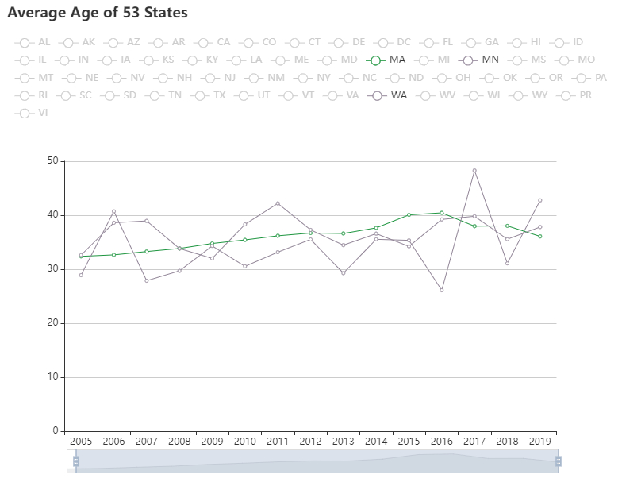
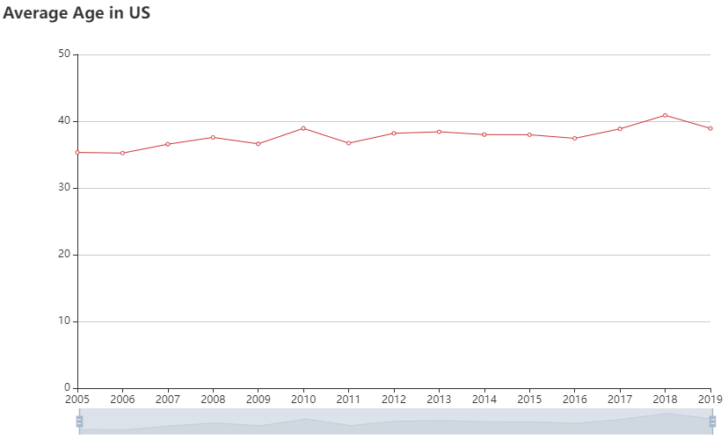
Analysis Part
Analyze the trends or patterns in the data
focus on
Population
Gender
Age
Income
Employment
Education

Slide 8
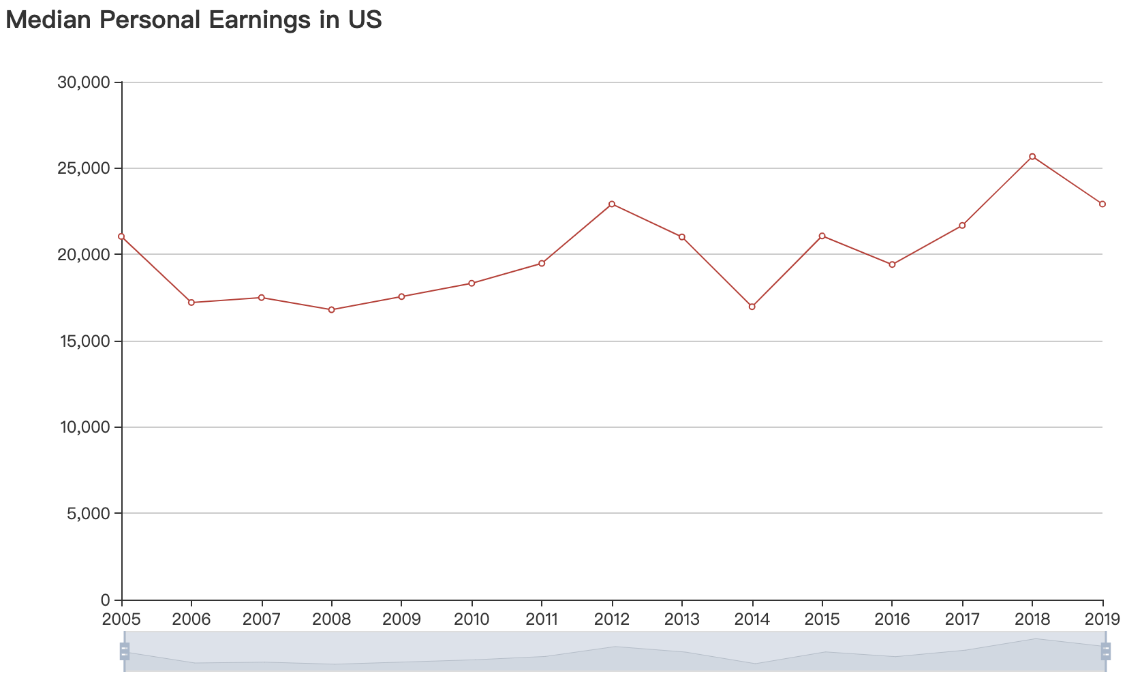
Analysis Part – Income Example
Increasing from 2006 to 2012
Decreasing from 2012 to 2014
Increasing again from 2016 to 2018

Slide 9
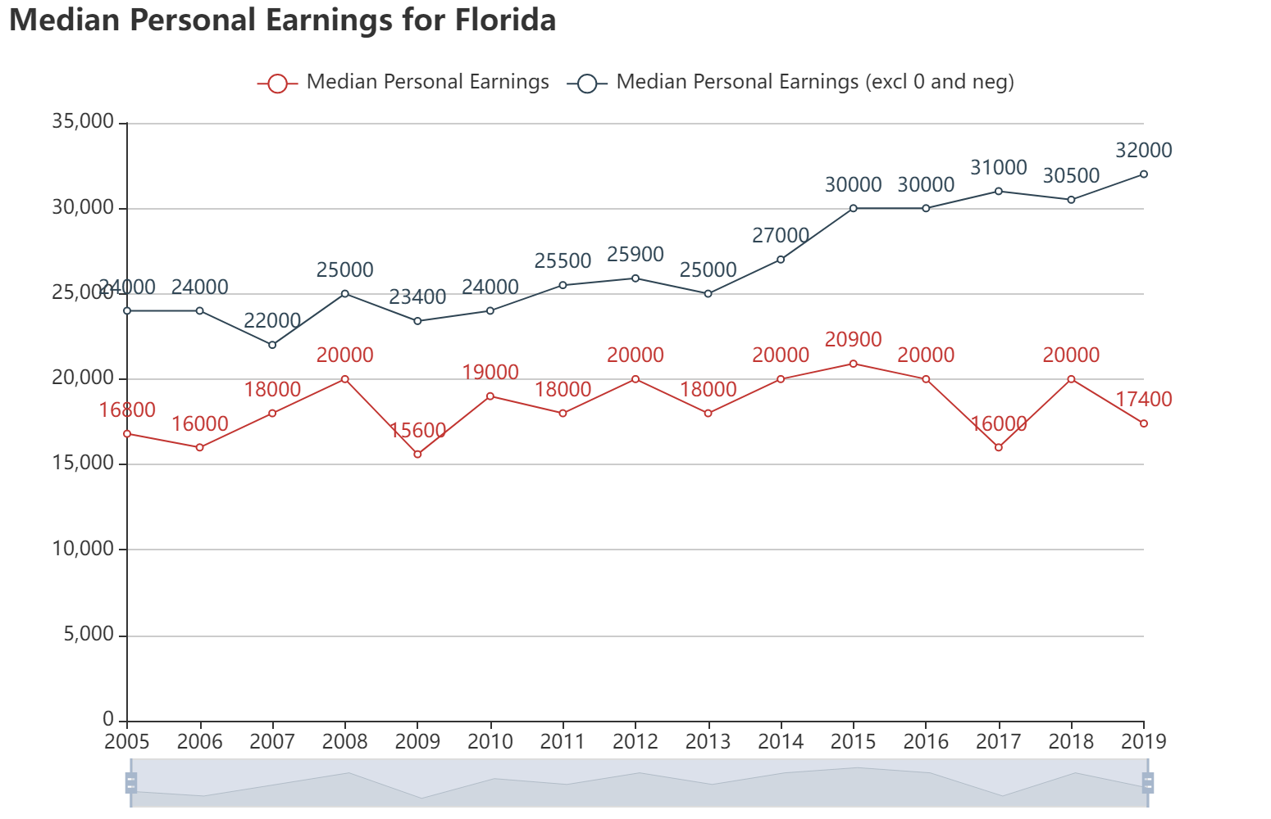
Analysis Part – Income Example
Increasing pattern for MA, CA, CT, FL, MI, NJ, NY, PA, TX.

Slide 10
Analysis Part – Income Example
Increasing pattern for MA, CA, CT, FL, MI, NJ, NY, PA, TX.

Slide 11
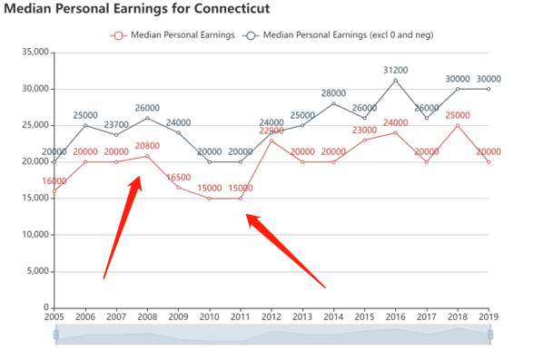
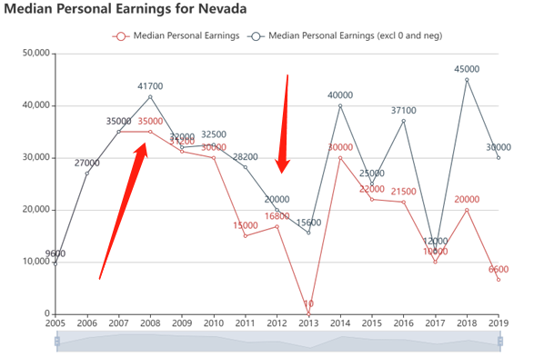
Analysis Part – Income Example
Decreasing pattern around 2008 to 2012 for AZ, CO, CT, MD, NV.

Slide 12
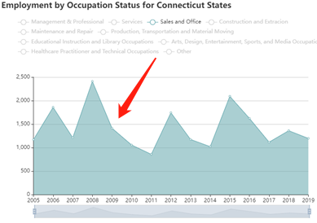
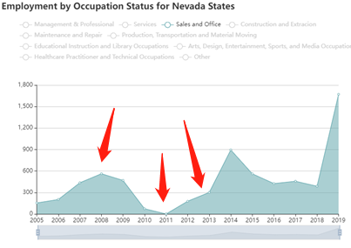
Analysis Part – Income Example
Decreasing pattern around 2008 to 2012 for AZ, CO, CT, MD, NV.
Related to employment?
Sales and Office as example

Slide 13
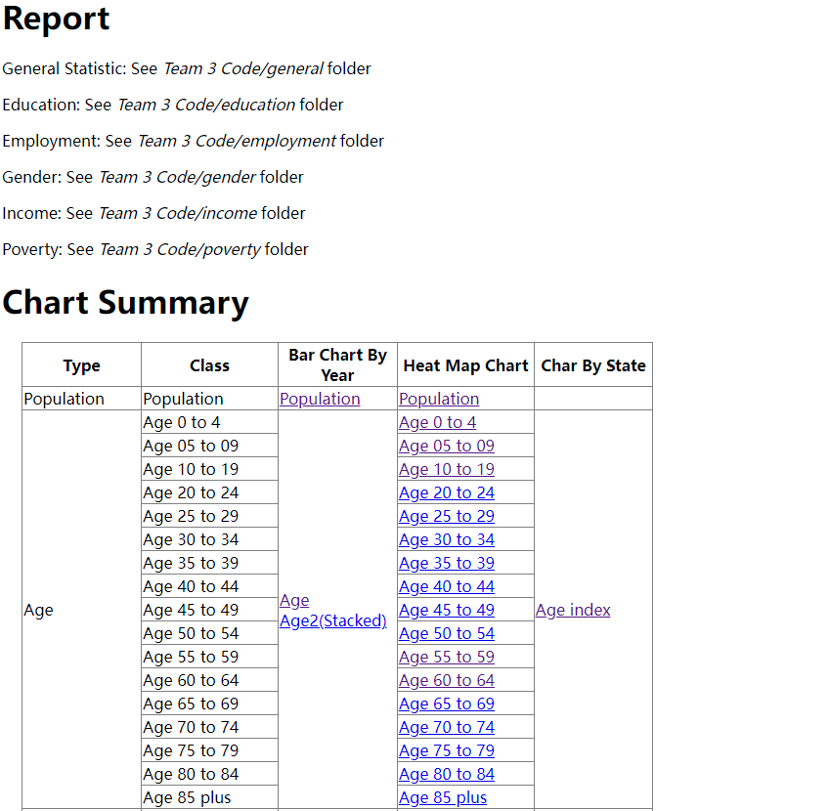
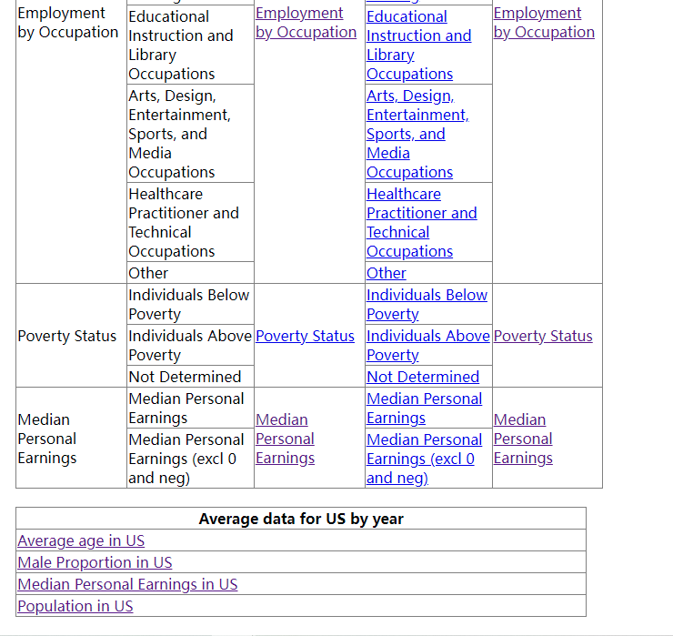
Portal Site
We add a portal web page to guide through all kinds of plot.
Notes:
At the end, we also make a simple portal website to organize all the plots. It includes all directory information about the analysis documents and charts.

Slide 14
Challenge & Limitation
Challenges
Visualization should allow the user to set date parameters.
Visualization including timeline.
The chart can be embedded into website.
Sort the data in descending order, show top 10 states.
Some patterns of demographics data are hard to predict.
Limitation
Data must be pre-sort by code.
Some features such as gender proportion changes rapidly and is unable to predict and analyze.
Relations between data is hard to tell.

Slide 15
Divide labor:
We divide labor equally and adapted to personal skills.
Plot by year: Zhihao Gu, Pengchao Yuan
Plot by states: Minghui yang, Xiaohan Zou
Data process: Chenyang Zhang
Heat Map: Pengchao Yuan
Data Analysis:
Age, Gender: Chenyang Zhang
Income: Zhihao Gu
Education: Minghui Yang
Employment: Xiaohan Zou
Poverty: Pengchao Yuan
Early Insight: Zhihao Gu
Final Presentation: Pengchao(presentation), Zhihao(slide)
Notes:
We divide labor equally and adapted to personal skills.

Slide 16
Thank You

